Slide 1
The digital footprints as a proxy for understanding human behavior
Diogo Pacheco, Ph.D.
12/07/2017

Slide 2
Agenda
Chronological order mixing BIO and professional
Maceió (1983-2001)
Recife (2002-2008)
Rio de Janeiro (2008-2013)
Melbourne (2013-2017)

Slide 3
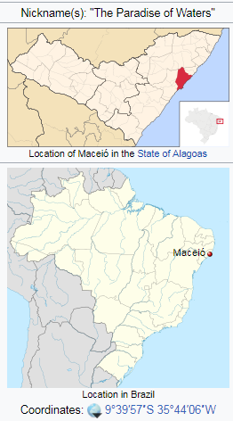
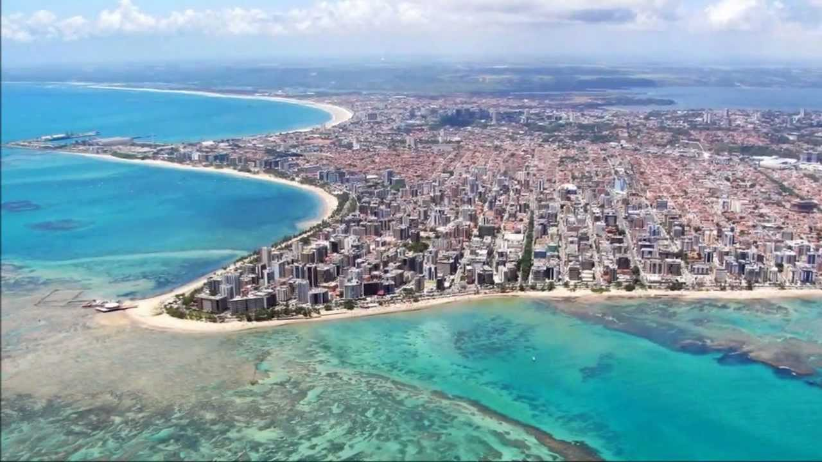
Maceió (1983-2001)
Poor and small city
Learned to focus on education

Slide 4
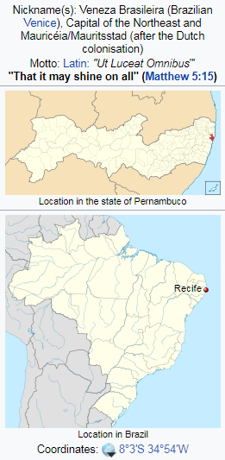
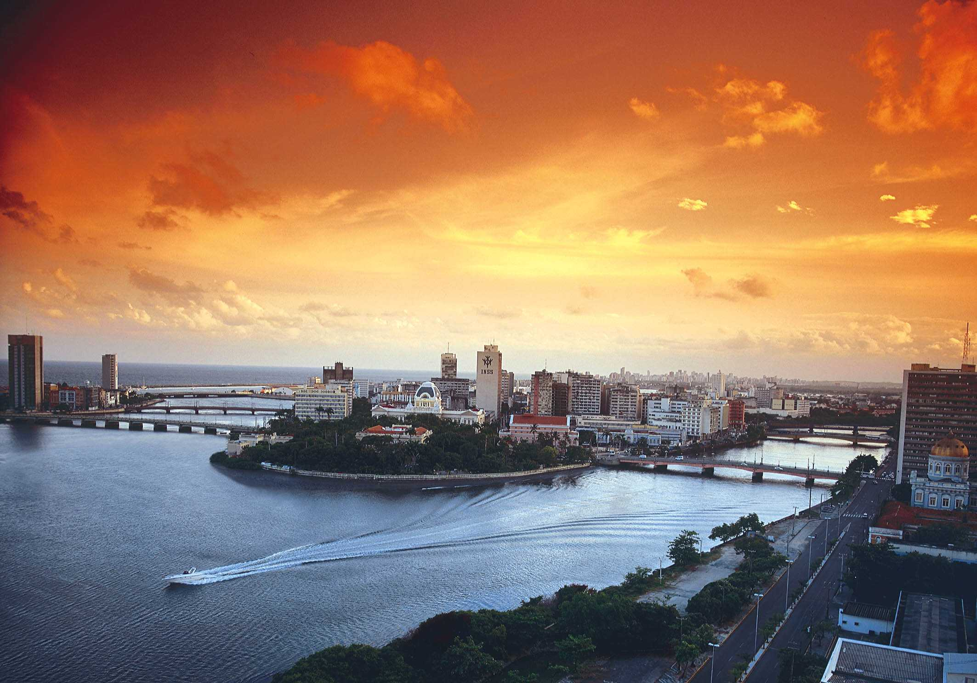
Recife (2002-2008)
Bachelors and Masters Computer Engineering
Reference in Computer Science

Slide 5

University of Pernambuco
Computational intelligence: artificial neural networks, fuzzy logic, genetic algorithms
Evolutionary multi-objective optimization
Application to decision support of sugarcane harvest
PACHECO, Diogo F.; OLIVEIRA, F. R. S. ; LIMA NETO, F. B. . Including Multi-Objective Abilities in the Hybrid Intelligent Suite for Decision Support. In: 2008 World Congress In Computational Intelligence (IJCNN - International Joint Conference On Neural Networks), 2008, Hong Kong.
PACHECO, Diogo F.; LIMA NETO, F. B. . A Fair Comparison of Representations, Operators and Algorithms for the Sugarcane Harvest Problem. In: IEEE International Conference on Systems, Man, and Cybernetics (SMC2008), 2008, Singapore.
PACHECO, Diogo F.; LUCAS, T. D. P. ; LIMA NETO, F. B. . How Preferences Affect Productivity in the Sugarcane Harvest Problem a Comparative Study of a Two-Steps MOEA. In: 8th International Conference on Hybrid Intelligent Systems (HIS 2008), 2008, Barcelona.
PACHECO, Diogo F.; LUCAS, T. D. P. ; LIMA NETO, F. B. . How to Obtain Fair Managerial Decisions in Sugar Cane Harvest Using NSGA-II. In: International Conference on Hybrid Intelligent Systems (HIS`07), 2007, Kaiserslautern, Germany.
OLIVEIRA, F. R. S.; PACHECO, Diogo F.; LIMA NETO, F. B. . Hybrid Intelligent Suite For Decision Support in Sugarcane. In: 6.Congresso Brasileiro de Agro-Informática (SBIAgro), 2007, São Pedro.
LINS, A. J. C. C. ; CALDAS, B. J. B. ; BASTOS FILHO, C. J. A. ; CARVALHO, D. F. ; PACHECO, Diogo F.; LIMA NETO, F. B. . A Novel Approach for Wavelength Assignment in Optical Links Based On Modified Genetic Algorithms. In: I Simpósio Brasileiro de Inteligência Computacional (SBIC), 2007, Florianópolis.
LIMA NETO, F. B. ; OLIVEIRA, F. R. S. ; PACHECO, Diogo F. . Hybrid Intelligent Suite for Decision Support. In: Seventh International Conference on Intelligent Systems Design and Applications (ISDA), 2007, Rio de Janeiro, Brazil.
OLIVEIRA, F. R. S. ; PACHECO, Diogo F.; LEONEL, A. ; LIMA NETO, F. B. . Intelligent Support Decision in Sugar Cane Harvest. In: IV World Congress On Computers In Agriculture (WCCA2006), 2006, Orlando.
PACHECO, Diogo F. ; REGUERIA, F. S. ; LIMA NETO, F. B. . Utilização de Redes Neurais Artificiais em Colheitas de Cana-de-açucar para Predição de TCC, TCH e Fibra. ALCOOLbrás, São Paulo, p. 60 - 63, 01 mar. 2005. (In portuguese)
Notes:
In my masters, I proposed a multi-objective hybrid intelligent suite for decision support, and I applied it to the sugarcane harvest problem. For instance, I used ANN to predict sugarcane's qualitative indicators; then, I combined the predicted data with logistics data as input for an Evolutionary Multi-Objective Optimization (EMOO) algorithm; finally, I used fuzzy logic to select and present the best candidate solutions to the decision maker

Slide 6
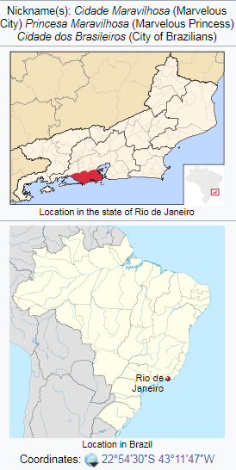
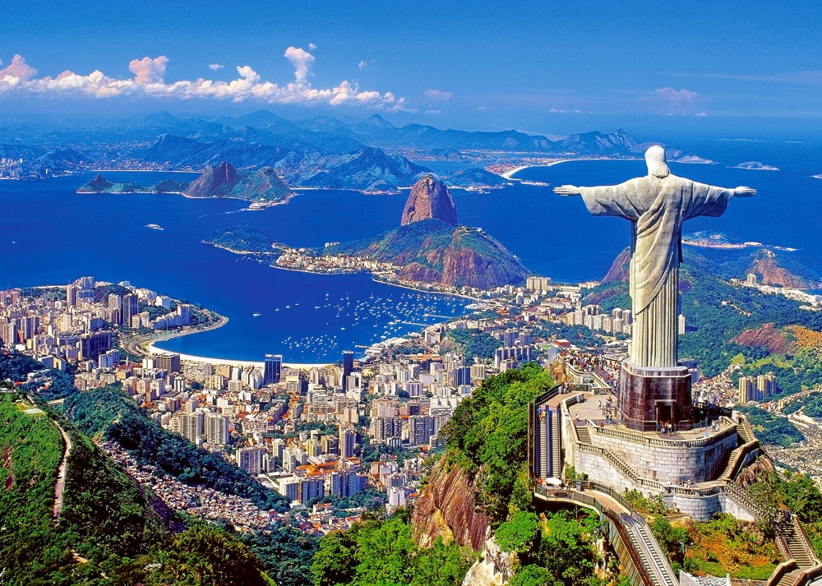
Rio de Janeiro (2008-2013)
“Rich” and big city

Slide 7
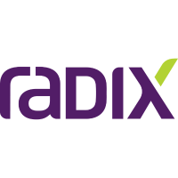
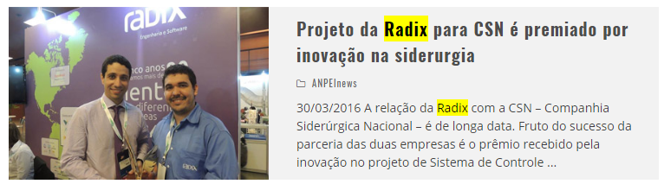



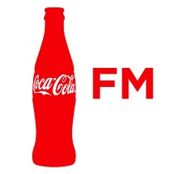
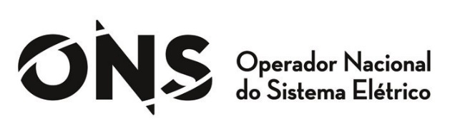



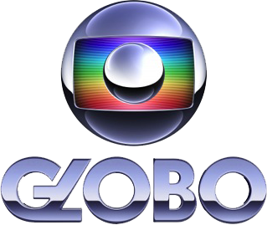

Software Development
Notes:
I worked for companies that mainly developed systems to industrial plants (e.g. oil\&gas and steelmaking sectors). Although most projects used ``traditional computation'', I could lead some special projects using ANN. For instance, I created the model for the ANN used to predict the temperature of ladle furnaces during the secondary refining operations during the steel production. This innovation lead the company to increase productivity and to reduce energy costs and this project won an innovation award in the sector.

Slide 8
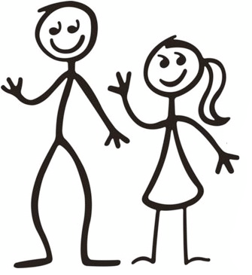

Slide 9
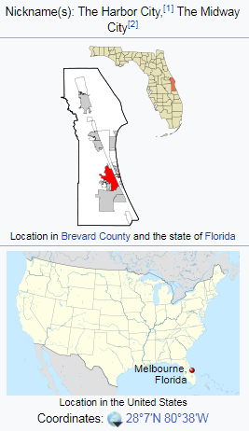
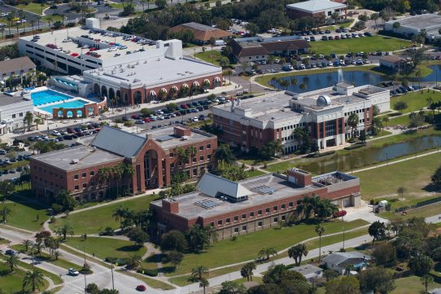
Melbourne (2013-2017)
New beginning
Notes:
I started my PhD in 2013 with focus on the exploration of social media data via the examination of the digital footprints as a proxy for understanding human behavior.

Slide 10

Florida Institute of Technology
Back to class after 5 years: statistics, machine learning (classification, anomaly detection, information retrieval, clustering, etc), complex networks.
New tools: R, python, mongodb.

Slide 11
How biased are the media?
Notes:
My first contribution in the area was in 2014. It is hard to describe how strong most people feel about the favoritism of the media towards certain political parties, events and people. Our world is not short of anecdotal accounts of how this or that media outlet demonstrate favoritism and perhaps reports the so called \truth". But what is the truth?

Slide 12
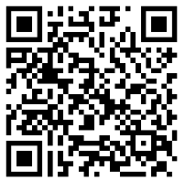
Using Interactions in the Quantification of Media Bias
10 major US newspapers
Political context (Senate)
Crawled media outlets, google search, Senate.gov
Co-sponsorship network (ground truth)
Co-citation networks
Fabrication, legitimacy, and negligence
PACHECO, Diogo; ROSE, D; LIMA NETO, F. B.; MENEZES, R.. Using Interactions in the Quantification of Media Bias. In: 2014 ASE BIGDATA / SOCIALCOM / CYBERSECURITY Conference, Stanford University, May 27-31, 2014.
Notes:
I built a co-sponsorship network from the US Senate and used it as ground truth in the investigation of media bias. I generated co-citation networks from the 10 major US newspapers; we analyzed whether specific parties were over-cited or suppressed by them.

Slide 13
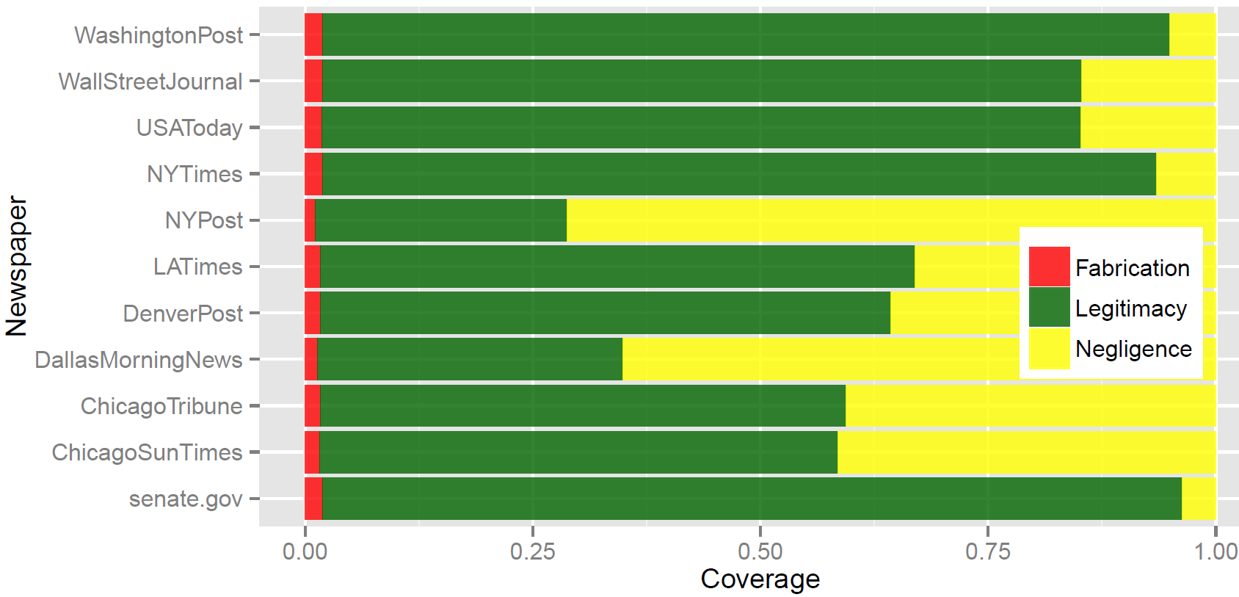
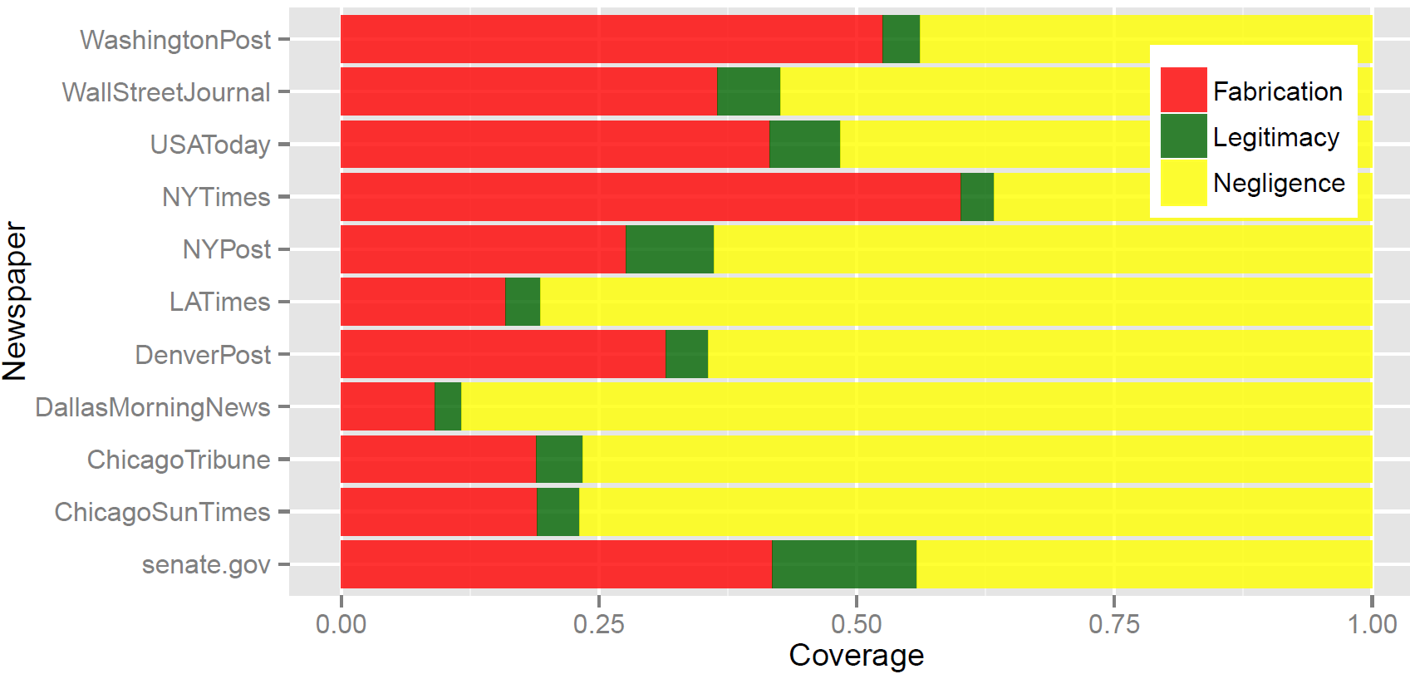
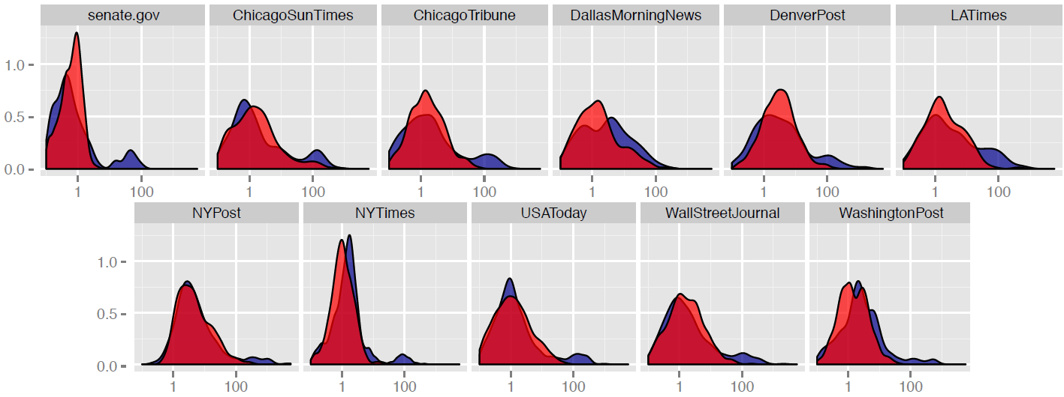
Using Interactions in the Quantification of Media Bias
Notes:
Despite claiming themselves as balanced and fair, the results revealed that most newspapers evaluated are biased towards the Democrats, being the NY Post the foremost. The exceptions are the Dallas Morning News, which favors the Republicans and the NY Times whose global bias is inconclusive,
We also submitted the senate.gov website to our evaluation and its bias was also inconclusive.

Slide 14
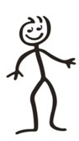

Slide 15
How biased are we?
Notes:
In the last few years, Twitter has been used to understand several realworld
events such as political elections, civil conflicts, NFL games, to name a
few. Motivated by these many examples we asked ourselves, what does Twitter
reveal about the 2014 FIFA World Cup?

Slide 16
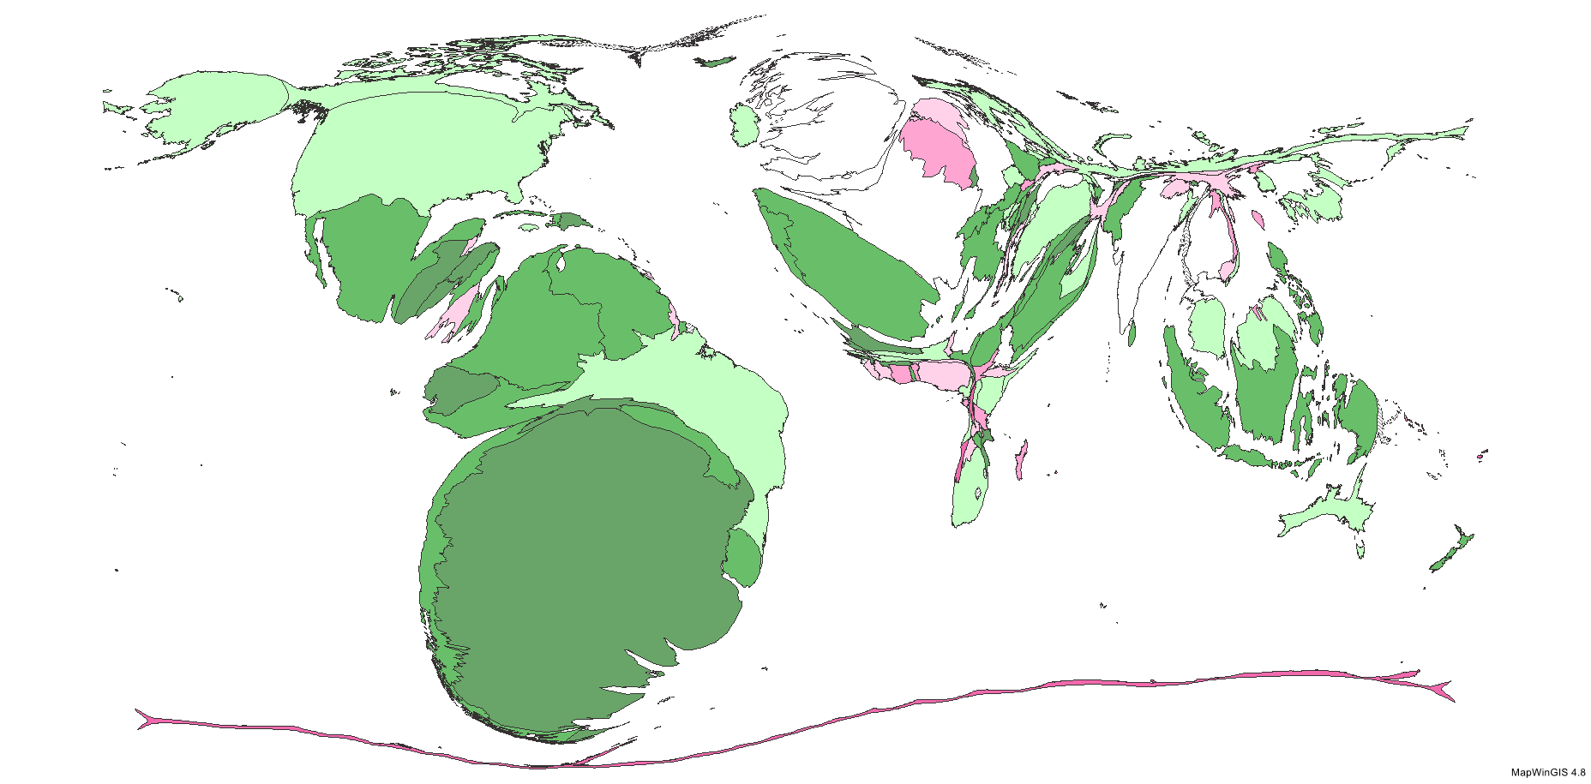
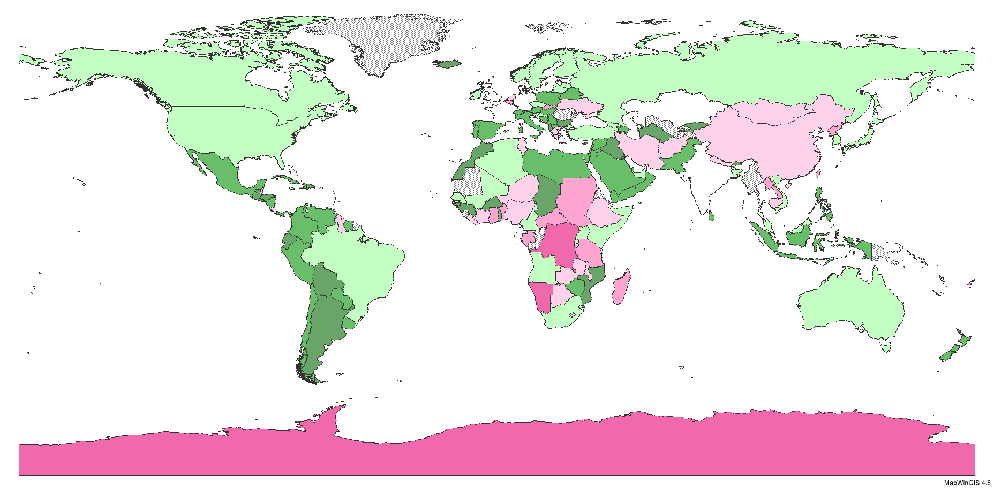
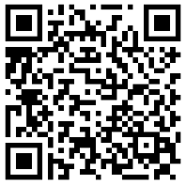
Football Conversations: What Twitter Reveals about the 2014 World Cup
Inspired by the actor-observer bias
50 million tweets
Characterize users as TF-IDF
Clustering and manual labeling
Score countries and cartograms
PACHECO, Diogo F.; LIMA NETO, F. B.; MOYANO, L. G.; MENEZES, R. . Football Conversations: What Twitter Reveals about the 2014 World Cup. In: IV Brazilian Workshop on Social Network Analysis and Mining (BraSNAM 2015), Recife - Brazil, July 21-23, 2015.
Notes:
Social psychologists demonstrated that different points of view about the same action can
emerge due to the so called actor-observer asymmetry [Jones and Nisbett 1971]. In experiments,
people have been shown camera shots from different angles for the same situation
and had two different understandings about what was shown [Malle 2006]. Could there
be differences within observers? In sport events, such as football (soccer), observers have
an a priori tendency to support their favorite team, that is, a bias already exists. If they
have similar bias do they arrive at the same conclusion about the sport event?

Slide 17
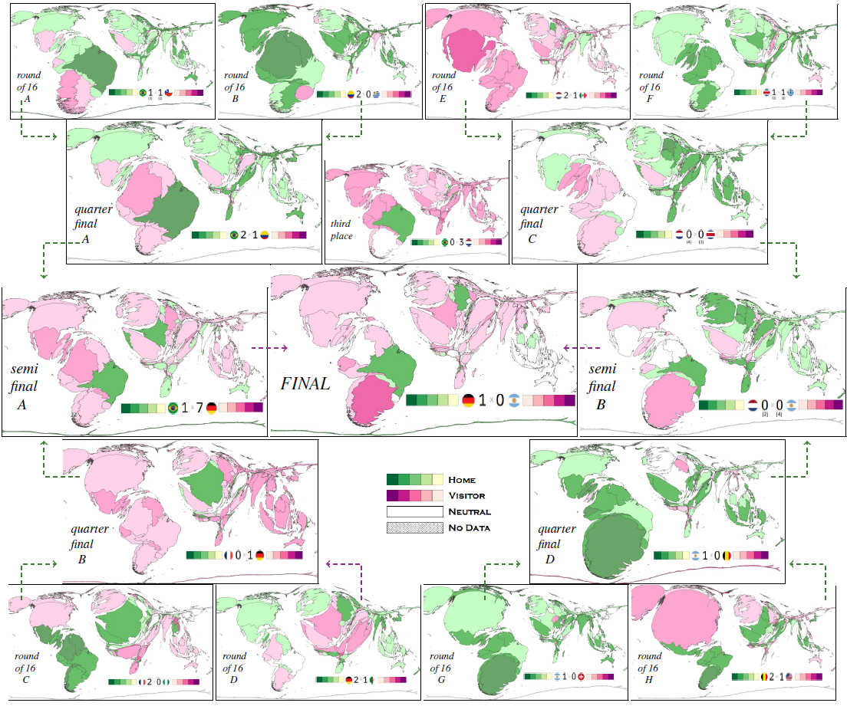
Football Conversations: What Twitter Reveals about the 2014 World Cup
Notes:
We clustered users by words they tweeted to construct cartograms and to demonstrate
how the world was divided during World Cup matches. The clusters formation
itself suggests an alternative approach to actor-observer asymmetry already demonstrated
by social psychologists. We observed the existence of rivals and allies, and large fluctuations
on countries’ prestige.

Slide 18
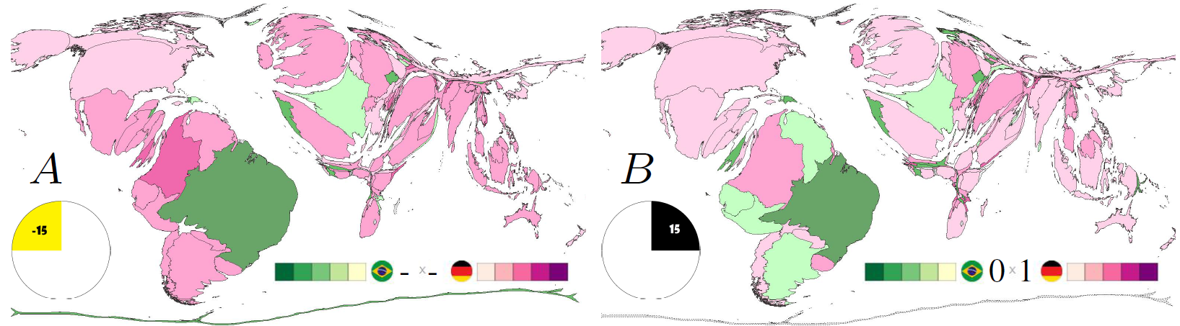
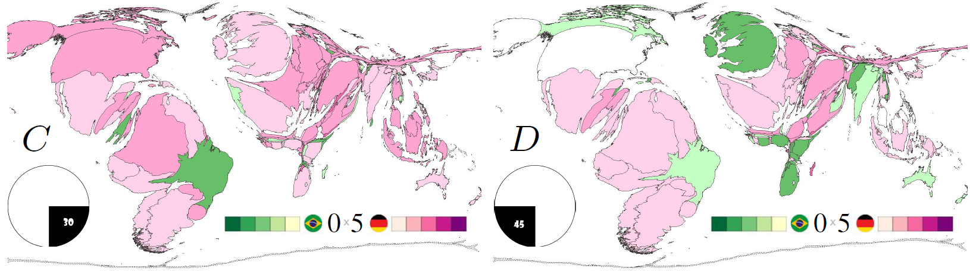
Football Conversations: What Twitter Reveals about the 2014 World Cup
Notes:
Shrink effect over Brazilian supporters after the unexpectedly 5 goals
in first half time. From left to right, each frame summarizes a 15-minute time
window, beginning a quarter before kickball and ending at 45 min of first half

Slide 19
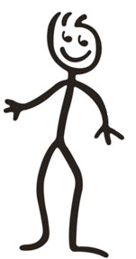

Slide 20
PhD Dissertation

Slide 21
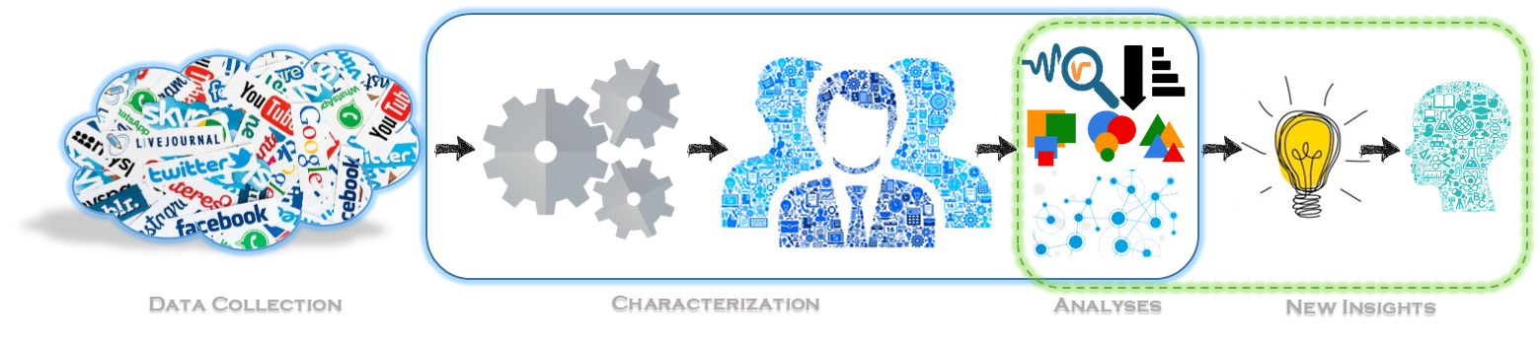
PhD Dissertation
Information Densification of Social Constructs via Behavior Analyses of Social Media Users - A Study on Twitter
Notes:
Can online social media data be used to identify behaviors and relationships from social actors in a meaningful way to enable knowledge extrapolation?
1. We can characterize users based on their social activity in relation to a set of entities.
2. These characterizations are proxy for society.
3. We can use these characterizations to extract knowledge about entities’ relationships and about of the interplay between entities and society.
4. The new knowledge is worthy and can be used to support research in other areas.

Slide 22
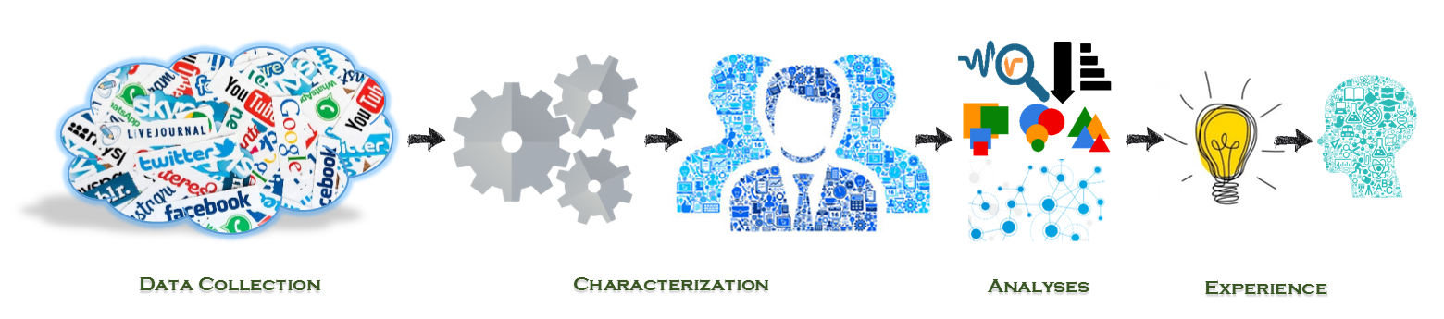
Learning From Social Media Data
Different Contexts:
Sports (Football)
Culture (Languages)
Health (Organ Donation)
Notes:
I proposed a data-driven approach to characterize online users based on their social behavior (posts). I used Twitter data to explore the interplay between social activities and their relationship with socio-economic factors. For instance, I characterized football supporters and clubs from the UK and Brazil; I also created language networks\cite{Pacheco2017SensingMedia} to investigate how languages spread; last, I used Twitter to understand the organ donation awareness in the US~\cite{Pacheco2017}.

Slide 23
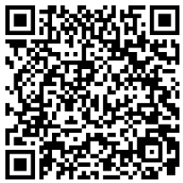
Characterization of Football Supporters from Twitter Conversations
Users based on a set of clubs.
Mentions to official Twitter accounts.
The UK and Brazil leagues.
Metrics high correlated to top -loved and -hated clubs lists.
Clubs cluster geographically.
Able to detect rivalry levels.
Applications: marketing, security, etc.
PACHECO, Diogo F.; PINHEIRO, Diego; LIMA NETO, F. B.; RIBEIRO, Eraldo; MENEZES, R. . Characterization of Football Supporters from Twitter Conversations. In: 2016 IEEE/WIC/ACM International Conference on Web Intelligence (WI' 16), October 13-16, 2016.

Slide 24
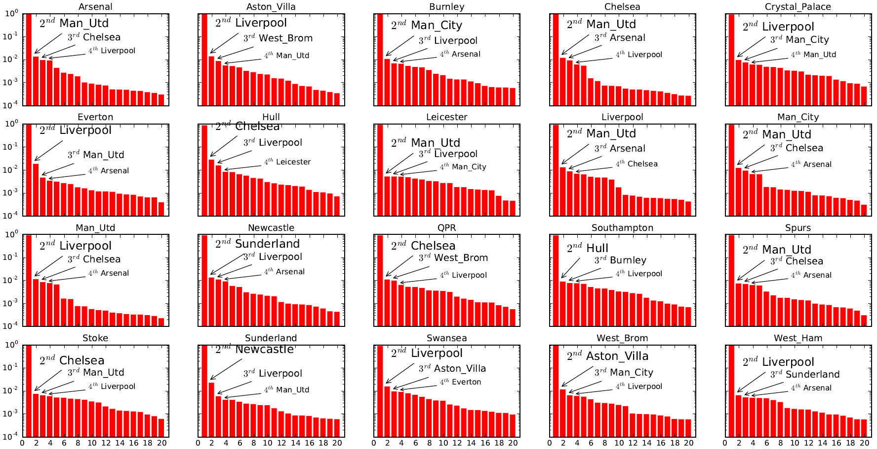
Characterization of Football Supporters from Twitter Conversations

Slide 25
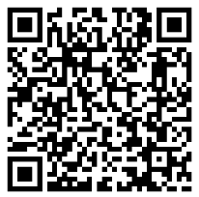
Sensing Language Relationships from Social Media
Users based on languages they tweet.
Understanding spread of languages.
12 Twitter datasets ~ 0.5 Billion tweets.
Locality effect.
Geographical proximity.
Applications: marketing, linguistics, cultural shift detection, etc.
PACHECO, Diogo F.; SAHA, Priya; LIMA-NETO, F. B.; MENEZES, R. . Sensing Language Relationships from Social Media. In: 2017 IEEE SmartWorld, Ubiquitous Intelligence and Computing, Advanced and Trusted Computed, Scalable Computing and Communications, Cloud and Big Data Computing, Internet of People and Smart City, August 4-8, 2017.
Notes:
Online social networks (e.g., Twitter) offer an open
platform for people to interact and connect without restrictions
of language usage or geographic borders. Because of their pervasiveness,
online social networks provide data and become realtime
sensors of society. This work looks at Twitter to reveal the
hidden relationship of languages that stems from users’ language
preference for writing their tweets. We show that the language
relationships are dependent of place by comparing 12 large-scale
datasets with different locality levels.

Slide 26
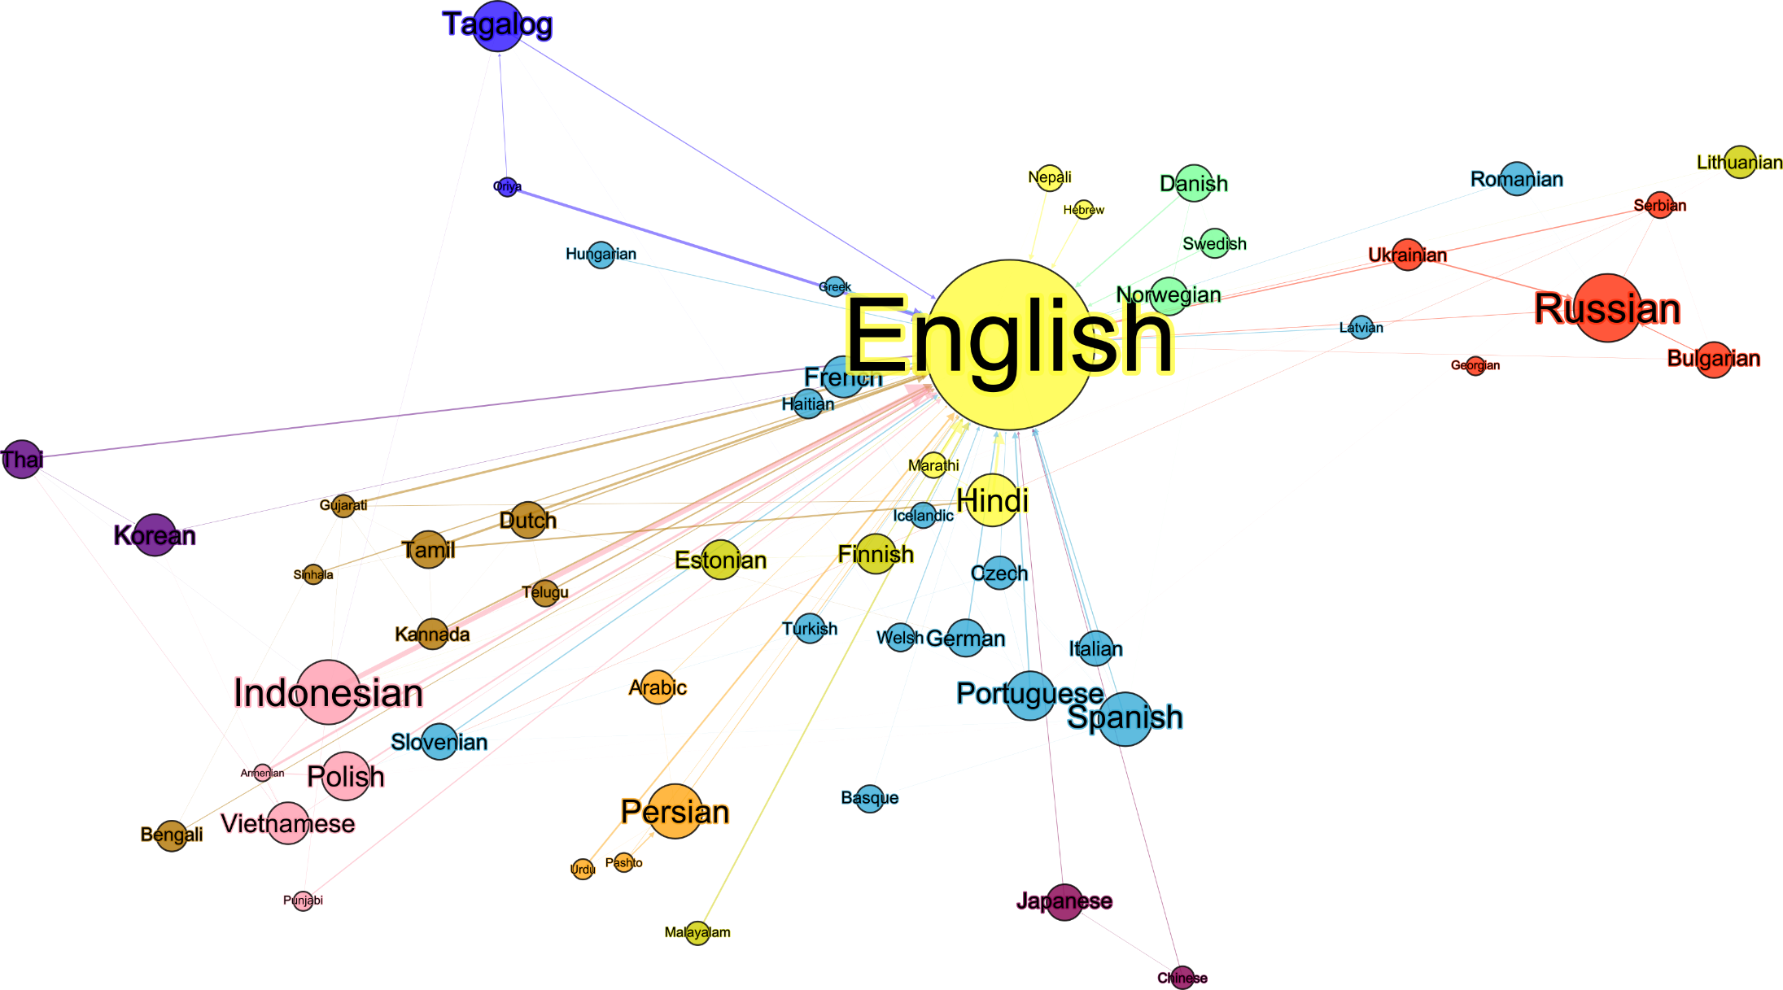
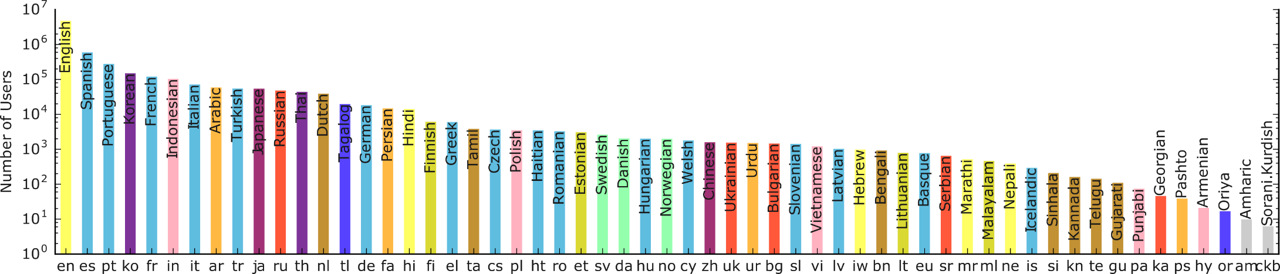
Sensing Language Relationships from Social Media

Slide 27
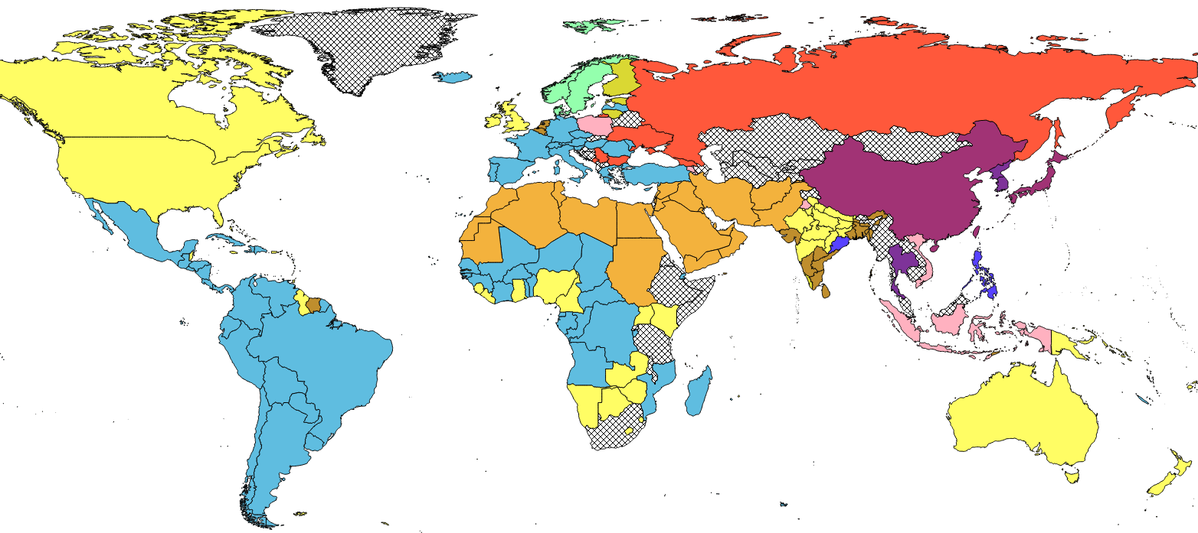



Sensing Language Relationships from Social Media
80% Arabic, 20% French
59% English, 22% French

Slide 28
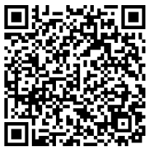
Characterizing Organ Donation Awareness from Social Media
Users based on organs.
US states show different necessities of organs.
Characterizations correlate to organs’ cascade failure.
Applications: health policies, social intervention, etc.
PACHECO, Diogo F.; PINHEIRO, Diego; CADEIRAS, Martin; MENEZES, Ronaldo. Characterizing Organ Donation Awareness from Social Media. In: Data Engineering Workshops (ICDEW), 2017 IEEE 33rd International Conference on, San Diego, California, USA, April 19-22, 2017.
Notes:
Approximately 22 people die every day in the USA
due to a lack of organs for transplant. Research suggests that the
most effective solution is to increase organ donor rates; one way is to performing mass media campaigns. However,
little is known about the extent in which activities on social
media are associated with aspects (e.g. awareness) of organ
donation. Our hypothesis is that social media can be utilized as a
sensor to characterize organ donation awareness and population
engagement in donation for each different organ

Slide 29
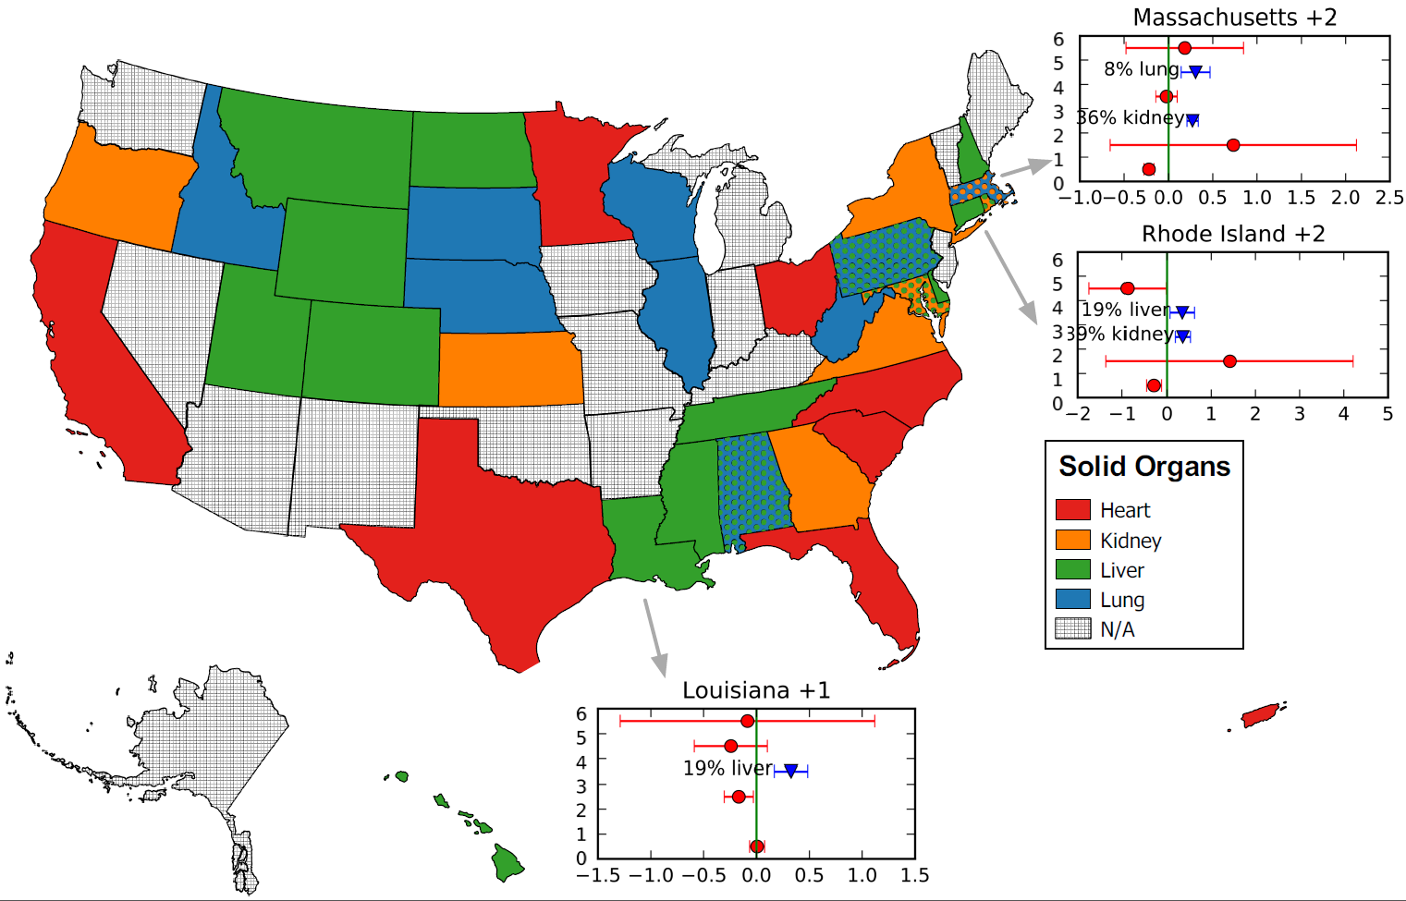
Characterizing Organ Donation Awareness from Social Media

Slide 30
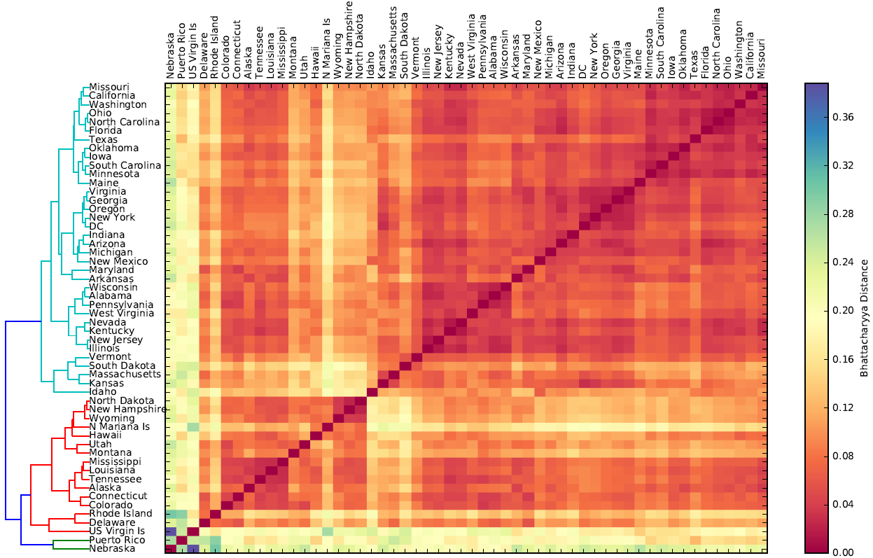
Characterizing Organ Donation Awareness from Social Media

Slide 31
Learning From Characterizations
Social Disorganization
Economic Development
Notes:
In addition, I used the diversity of supporters in a region as a proxy to social disorganization in order to explain crime rates.
We used the language networks\cite{Pacheco2017SensingMedia} to investigate at which extent their centrality correlates with the human develop index

Slide 32
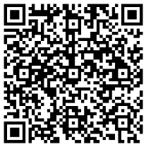
Using Social Media to Assess Neighborhood Social Disorganization: A Case Study in the United Kingdom
Social disorganization and crime.
Difficulty of measuring social disorganization.
Twitter Football Social Disorganization Crime?
Regression models.
The proposed metric presents better results in more populated and more disorganized regions.
PACHECO, Diogo F.; OLIVEIRA, Marcos; MENEZES, Ronaldo. Using Social Media to Assess Neighborhood Social Disorganization: A Case Study in the United Kingdom. In: the 30th Florida Artificial Intelligence Research Society Conference, Marco Island, Florida, USA, May 22-24, 2017.
Notes:
Crime takes place unevenly across places in cities. This characteristic of crime is argued by ecological criminologists to be the outcome of features in the social fabric of the places themselves (Henry and Einstadter 2006). Social ecologists highlight the active role of place in criminal occurrence and consider crime as the product of social disorganization which is produced by social changes, such as immigration, rural-urban migration, high social mobility, among others.
In this paper we propose a measure of social disorganization in places by examining geotagged tweets. We characterize a place using the entropy of football supporters in the region. Due to its popularity, it is hard to imagine the behavior of the supporters as independent from other aspects of society, particularly in
places such as Brazil, Italy, Germany, and the United Kingdom.

Slide 33
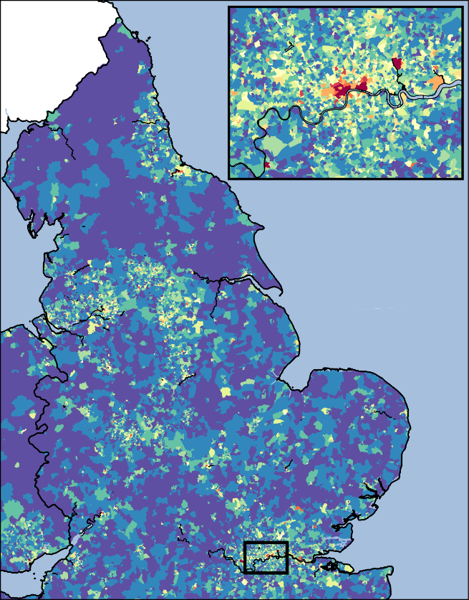
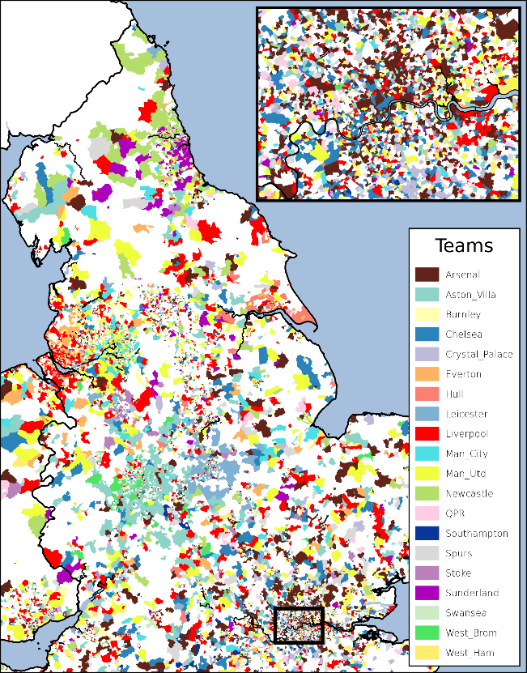
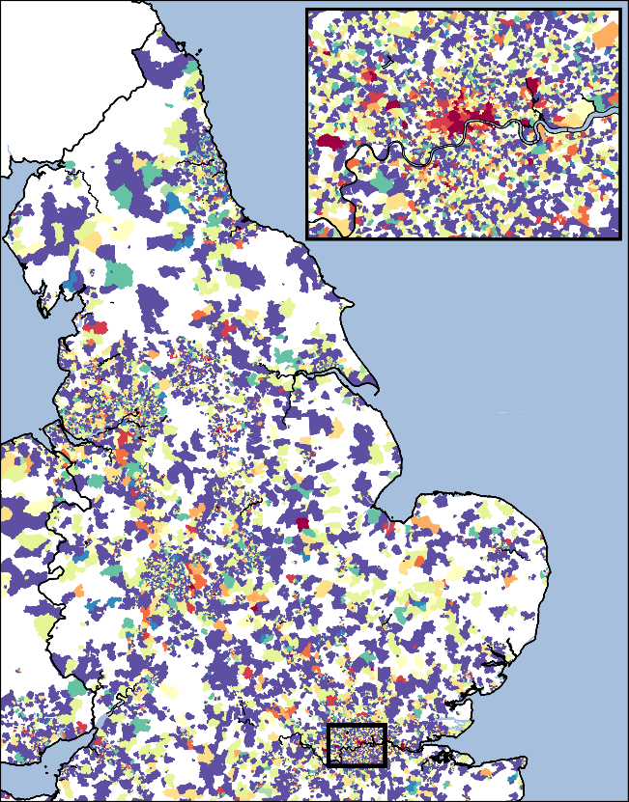
Using Social Media to Assess Neighborhood Social Disorganization: A Case Study in the United Kingdom
Crime Concentration | Characterization | Entropy of supporters
High
Low

Slide 34
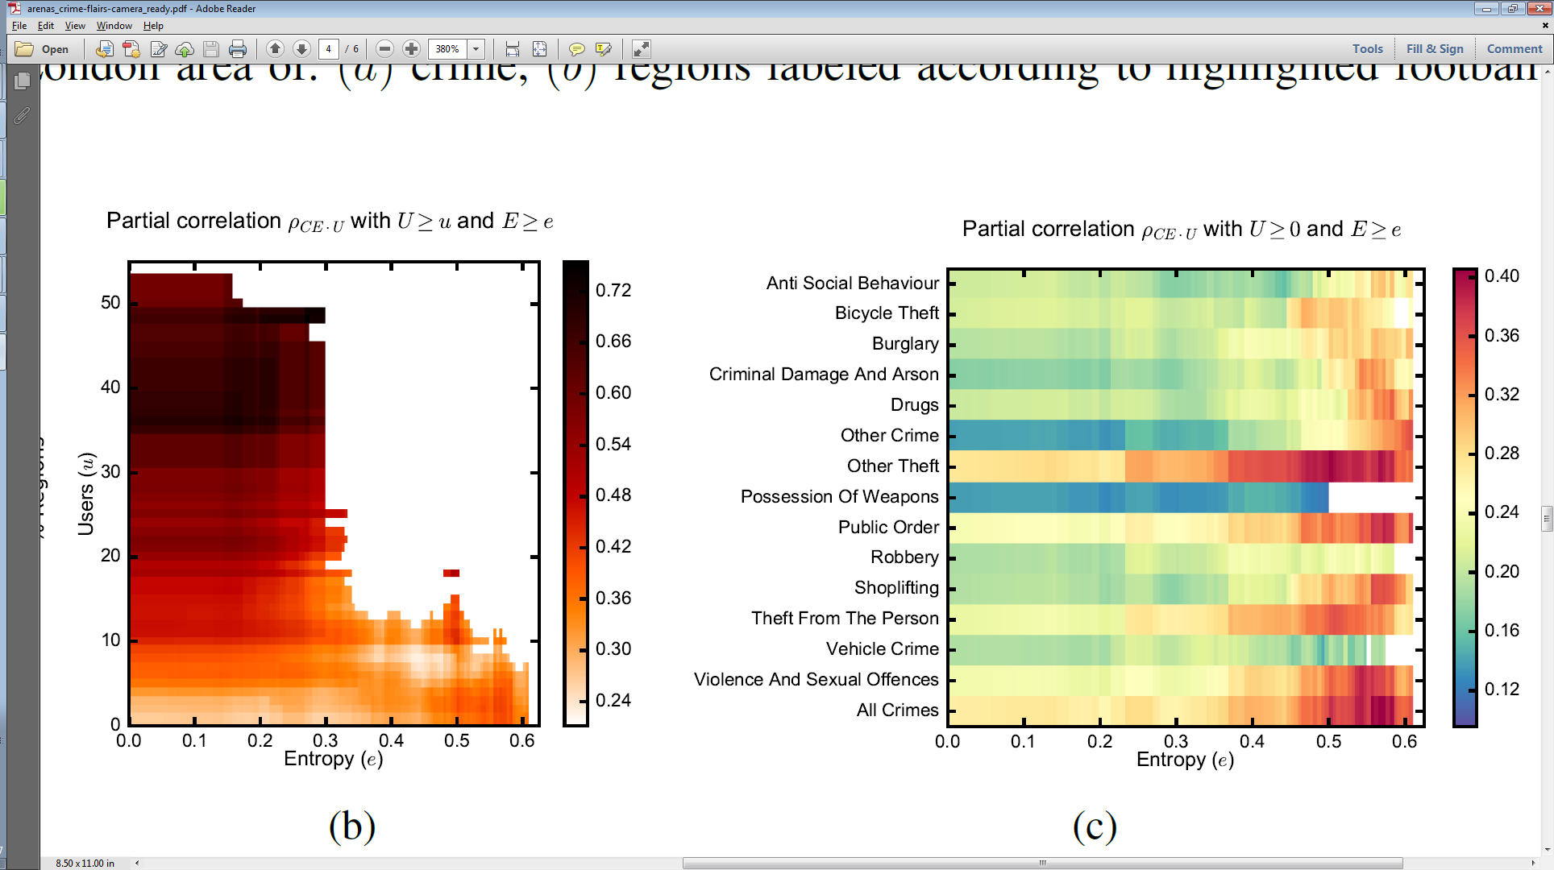
Using Social Media to Assess Neighborhood Social Disorganization: A Case Study in the United Kingdom
Notes:
We observed a significant correlation between the number of users and crime, and between the entropy of supporters and crime. Then, we measured the partial correlation between them to confirm that the entropy correlation was not inflated by the population effect. Finally, we used regression models to confirm the contribution of both, the number of users and their entropy, to model crime activity. The coefficients for entropy
are statistically significant, regardless the type of crime. We also found that our proposed measure of social
disorganization explains better the variation of crime among regions with higher disorganization and larger population. This work is a first attempt to create a framework to assess the levels of social disorganization in locations by using social media. It is worth noticing that this is the contribution of this paper and that the example with the UK football is a case study to demonstrate that certain subjects (in this case football) can be used to quantify social disorganization.

Slide 35
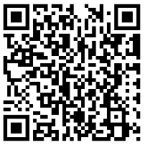
Language as a Measure of Welfare
Can languages used by people on Twitter act as a proxy to their development scale?
This study shows that the users of languages that hold favored positions in the networks tend to have better life more than a chance.
SAHA, Priya; PACHECO, Diogo F.; MENEZES, Ronaldo. Language as a Measure of Welfare. In: the 30th Florida Artificial Intelligence Research Society Conference, Marco Island, Florida, USA, May 22-24, 2017.

Slide 36
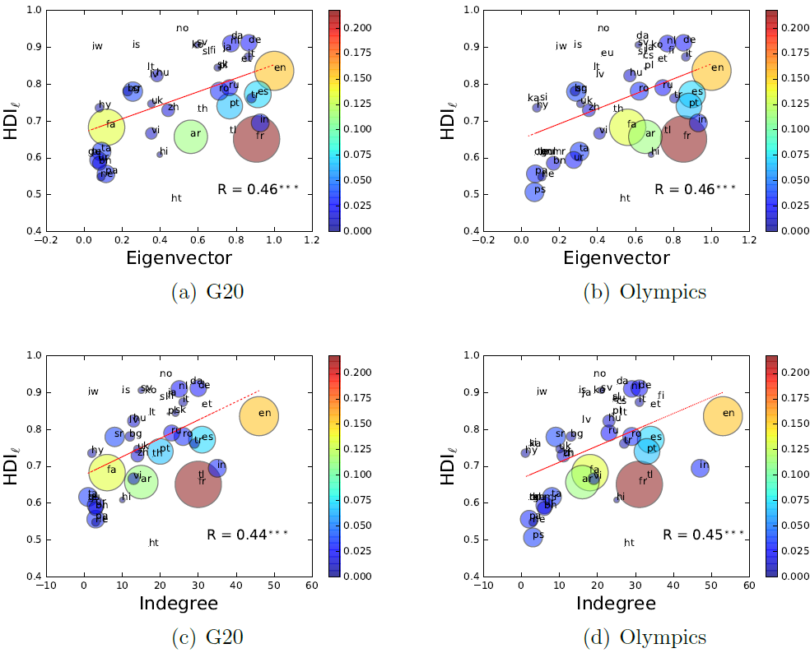
Language as a Measure of Welfare

Slide 37
Conclusions

Slide 38
Conclusions
Social media data is very rich.
The abundance of data can help us to confirm and develop social theories.
Computational social science can provide powerful tools to enhance our understanding about society.

Slide 39
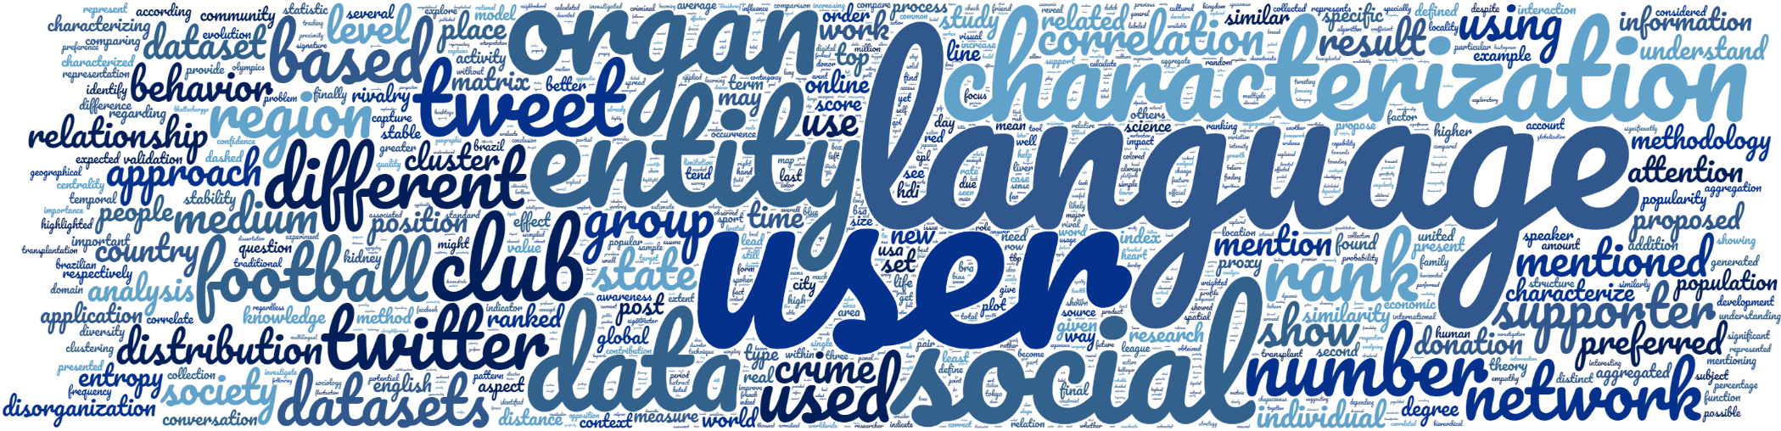
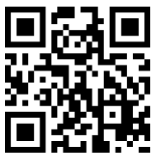
Questions?
Diogo Pacheco – https://diogofpacheco.github.io/

Slide 40
Extra

Slide 41
Predicting Human Dynamics Under Partial Information
Investigating the limits of predictability
The interplay between social encounters and human mobility

Slide 42
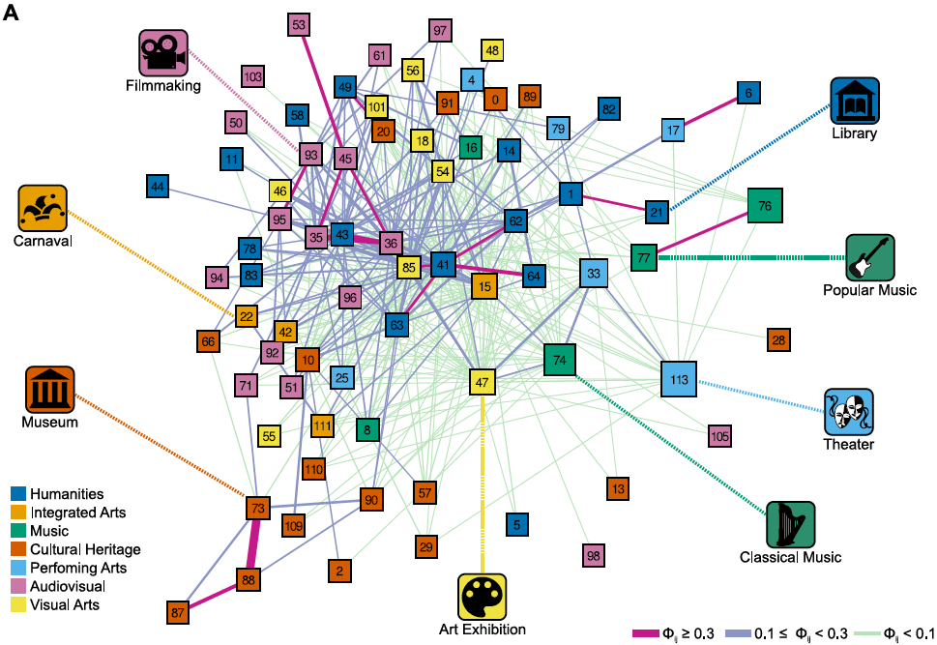
Cultural Space

